Slide 1
Clustering algorithms

Slide 2
Agenda
Introduction
Types
Top clustering algorithms

Slide 3

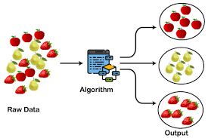
Clustering is an unsupervised machine learning task. A cluster is a group of data points that are similar to each other based on their relation to surrounding data points..

Slide 4

There are different types of clustering algorithms that handle all kinds of unique data Density Based Distribution Based CeNtroid Based Hierarcial Based

Slide 5
CENTROID Based
A centroid is a data point that represents the center of the cluster.
Centroid-based clustering organizes the data into non-hierarchical clusters.
Sensitive to initial conditions and outliers.

Slide 6
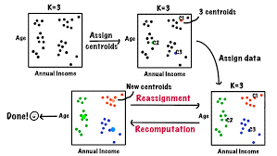
Two centroid based algorithms are:
1.Kmeans- Works for numerical data
2.K mode-Works for categorical data

Slide 7
The K-Means algorithm can be summarized into the following steps
Initialization − Select K random data points as the initial centroids.
Assignment − Assign each data point to the closest centroid.
Recalculation − Recalculate the centroids by taking the mean of all data points in each cluster.
Repeat − Repeat steps 2-3 until the centroids no longer move or the maximum number of iterations is reached.

Slide 8
Limitations
Sensitivity to the initial centroids.
Tendency to converge to local optima.
Assumption of equal variance for all clusters.
Advantage:
The K-Means algorithm is a straightforward and efficient algorithm.
It can handle large datasets.

Slide 9
Implementation in Python
kmeans = KMeans(n_clusters=3,max_iter=100) kmeans.fit(X)
Applications
Image Segmentation
Customer Segmentation
Anomaly Detection
Genomic Data Analysis

Slide 10
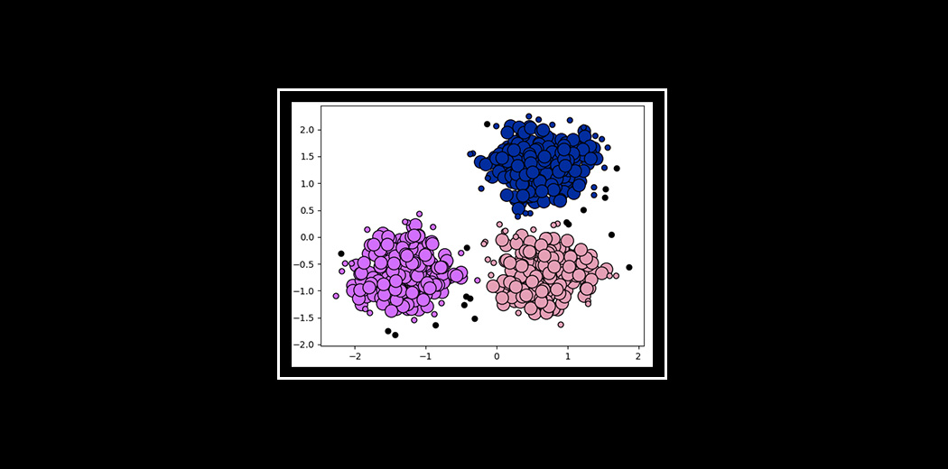
Density Based
Data is grouped by areas of high concentrations of data points surrounded by areas of low concentrations of data points.
Clusters can be any shape.

Slide 11
DBSCAN Algorithm
Data points movement based on Euclidean distance
Python implementation
from sklearn.cluster import DBSCAN
db = DBSCAN(eps=0.3, min_samples=10).fit(X)

Slide 12
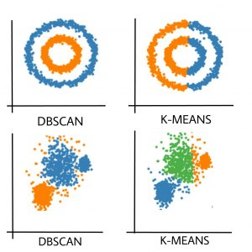
Difference Between DBSCAN and K-Means.
DBSCAN | K-Means
In DBSCAN we need not specify the number of clusters. | K-Means is very sensitive to the number of clusters so it need to specified
Clusters formed in DBSCAN can be of any arbitrary shape. | Clusters formed in K-Means are spherical or convex in shape
DBSCAN can work well with datasets having noise and outliers | K-Means does not work well with outliers data. Outliers can skew the clusters in K-Means to a very large extent.
In DBSCAN two parameters are required for training the Model | In K-Means only one parameter is required is for training the model

Slide 13
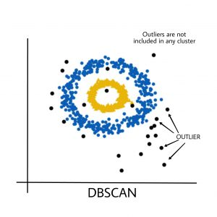
FACTORS IN DBSCAN
Core — This is a point that has at least m points within distance n from itself.
Border — This is a point that has at least one Core point at a distance n.
Noise — This is a point that is neither a Core nor a Border. And it has less than m points within distance n from itself.
OUTPUT

Slide 14
OPTICS Algorithm
It can extract clusters of varying densities and shapes. It is useful for identifying clusters of different densities in large, high-dimensional datasets.
The algorithm builds a density-based representation of the data by creating an ordered list of points called the reachability plot. Each point in the list is associated with a reachability distance, which is a measure of how easy it is to reach that point from other points in the dataset. Points with similar reachability distances are likely to be in the same cluster.
The OPTICS algorithm main steps:
Define a density threshold parameter, Eps, which controls the minimum density of clusters.
For each point in the dataset, calculate the distance to its k-nearest neighbors.
Starting with an arbitrary point, calculate the reachability distance of each point in the dataset, based on the density of its neighbors.

Slide 15
Order the points based on their reachability distance and create the reachability plot.
Extract clusters from the reachability plot by grouping points that are close to each other and have similar reachability distances.
It extracts the clustering structure of the data and produces the reachability plot. This allows the user to have more flexibility in selecting the number of clusters, by cutting the reachability plot at a certain point.
Python Implementation
from sklearn.cluster import OPTICS
# Fit the OPTICS model
clustering = OPTICS(min_samples=20, xi=.05, min_cluster_size=.05)
clustering.fit(X)

Slide 16
OPTICS Clustering v/s DBSCAN Clustering:
Memory Cost : The OPTICS clustering technique requires more memory as it maintains a priority queue (Min Heap).
Fewer Parameters : Reduction of the analytical process of parameter tuning.
Handling varying densities: OPTICS can identify clusters of different sizes and shapes more effectively than DBSCAN in datasets with varying densities.
Cluster extraction: OPTICS produces a reachability distance plot that can be used to extract clusters at different levels of granularity.
Noise handling: OPTICS may be less effective at identifying small clusters that are surrounded by noise points, as these clusters may be merged with the noise points in the reachability distance plot.
Runtime complexity: The runtime complexity of OPTICS is generally higher than that of DBSCAN, due to the use of a priority queue to maintain the reachability distances. However, OPTICS, is more scalable for large datasets.

Slide 17
Mean Shift Algorithm
Mean Shift is a technique for grouping comparable data factors into clusters primarily based on their inherent characteristics.
Mean Shift is a mode-seeking algorithm, which means that it finds the modes (peaks) of the density distribution of the data. This is in contrast to centroid-based clustering algorithms, such as K-Means clustering, which find the centroids of the clusters.
Mean Shift works by iteratively refining the positions of the data points, moving them towards the modes of the density distribution. This process is repeated until the data points converge to the modes of the density distribution.

Slide 18
Key Concepts of Mean-Shift Clustering
The fundamental idea at the back of KDE is to vicinity a kernel (a clean, continuous, and symmetric feature, usually a Gaussian) on each information point and sum those kernels to estimate the PDF. The formula for KDE, as mentioned in advance, is:
f_{k}(u) =\frac{1}{nhd}\sum_{i=1}^{n}K(\frac{u-u_{i}}{h})
f_{k}(u) is the estimated PDF at point
n is the number of data points.
d is the dimensionality of the data.
u-ui represents each data point.
K is a kernel function.
h is the bandwidth, a smoothing parameter.

Slide 19
2- Choosing the Right Bandwidth/Radius:
The desire of bandwidth (h) in Mean Shift and KDE is crucial as it notably affects the smoothness and accuracy of the predicted PDF.
3- Convergence:
Convergence in Mean Shift occurs when the data points stop moving significantly.
4- Bandwidth Kernel Function:
The bandwidth kernel function is a function that is used to weight the data points when calculating the mean shift vector.
5- Mean shift vector:
The mean shift vector for a data point points in the direction of the highest density of data points around it.
Python Implementation
from sklearn.cluster import MeanShift
mean_shift = MeanShift()
mean_shift.fit(X) #X is input

Slide 20
Comparing Mean Shift with K-Means
The Mean Shift algorithm is a mode-seeking algorithm that finds the most common values in the data and groups the data points around those values.
The K-Means algorithm is a centroid-based algorithm that groups the data points into a predefined number of clusters.

Slide 21
Affinity Based Algorithm
Data point movement based on similarity matrix, availability matrix, responsibility matrix.
Affinity Propagation discovers cluster centres and assigns data points to clusters autonomously.
It is particularly useful when the number of clusters is not known in advance or when the data doesn’t conform to spherical or convex cluster shapes.
It utilizes “exemplars,” which are typical data points representing other data points within the same cluster.
Algorithm is especially suitable for data with numerous clusters or data exhibiting intricate, non-linear distribution patterns.
The algorithm iteratively updates the responsibility and availability matrices until a stopping criterion is met. This could be a predefined number of iterations or until the algorithm converges.

Slide 22
Affinity Propagation for clustering has several benefits
Automatic Cluster Center Detection: Affinity Propagation automatically identifies cluster centers and total number of clusters which makes it suitable for datasets with an unknown or variable number of clusters and useful for large complex real-world datasets.
Robust to Noise and Outliers: Affinity Propagation is relatively robust to noise and outliers in the data which makes it useful in various applications like image segmentation, document clustering and biological dataset analysis etc.
Handles Non-Spherical Clusters: Unlike some traditional clustering algorithms, Affinity Propagation can handle clusters of various shapes and sizes.
Scalability: It can be applied to large datasets, although it may require optimization for computational efficiency.

Slide 23
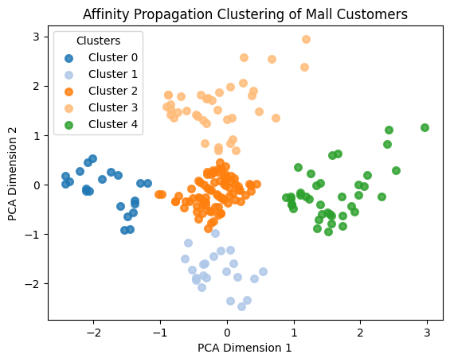
PYTHON IMPLEMENTATION
from sklearn.cluster import AffinityPropagation
model = AffinityPropagation(preference= -30, max_iter=50, damping=0.7, random_state=42, convergence_iter=20).fit(X_std) #X_std is standarized data

Slide 24
Distribution Based
All the data points are considered parts of a cluster based on the probability that they belong to a given cluster.
GMM has ability to handle overlapping clusters, model the covariance structure of the data, and provide probabilistic cluster assignments for each data point.

Slide 25
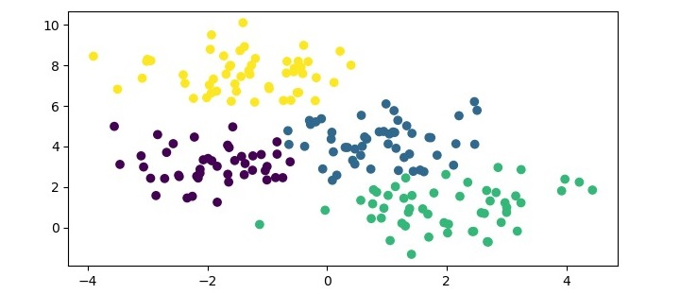
Gaussian Mixture Model
Each Gaussian Mixture distribution represents a cluster.
Ability to handle overlapping clusters, model the covariance structure of the data, and provide probabilistic cluster assignments for each data point.
python implementation
from sklearn.mixture import GaussianMixture
gmm = GaussianMixture(n_components=4) #creatng instance
gmm.fit(X) #X is the input.
Output:
When we create an instance of the GaussianMixture class with 4 components

Slide 26
Advantages of Gaussian Mixture Models
Gaussian Mixture Models (GMM) can model arbitrary distributions of data, making it a flexible clustering algorithm.
It can handle datasets with missing or incomplete data.
It provides a probabilistic framework for clustering, which can provide more information about the uncertainty of the clustering results.
It can be used for density estimation and generation of new data points that follow the same distribution as the original data.
It can be used for semi-supervised learning, where some data points have known labels and are used to train the model.

Slide 27
disAdvantages of Gaussian Mixture Models
GMM can be sensitive to the choice of initial parameters, such as the number of clusters and the initial values for the means and covariances of the clusters.
It can be computationally expensive for high-dimensional datasets, as it involves computing the inverse of the covariance matrix, which can be expensive for large matrices.
It assumes that the data is generated from a mixture of Gaussian distributions, which may not be true for all datasets.
It may be prone to overfitting, especially when the number of parameters is large or the dataset is small.
It can be difficult to interpret the resulting clusters, especially when the covariance matrices are complex.

Slide 28
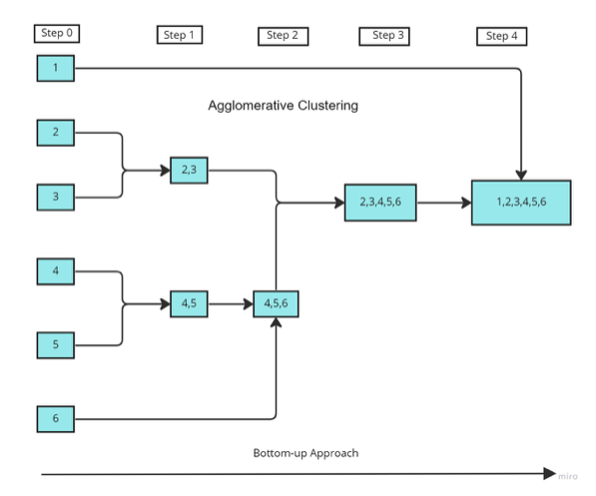
Hierarchial Based builds a tree of clusters so everything is organized between the clusters. The 'ward' method is used to calculate the distances between the clusters. It minimizes the variance of the distances between the clusters being merged. Dendrogram shows the hierarchical relationship .
Agglomerative Clustering
It is a bottom-up approach that produces a dendrogram.

Slide 29
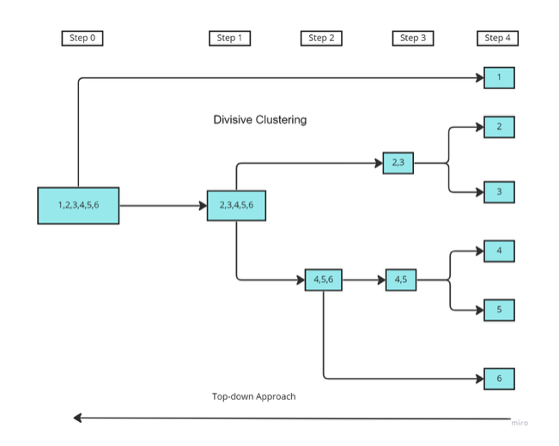
Divisive Clustering
It is a top-down approach.

Slide 30
Implementation in Python
from sklearn.datasets import load_iris
from sklearn.cluster import AgglomerativeClustering
from scipy.cluster.hierarchy import dendrogram, linkage
iris = load_iris() X = iris.data
to create the linkage matrix.
Z = linkage(X, 'ward’)
The 'ward' method is used to calculate the distances between the clusters. It minimizes the variance of the distances between the clusters being merged.
We can visualize the dendrogram using the dendrogram function from the same module.
y = iris.target
plt.figure(figsize=(7.5, 3.5)) plt.title("Iris Dendrogram") dendrogram(Z) plt.show()

Slide 31
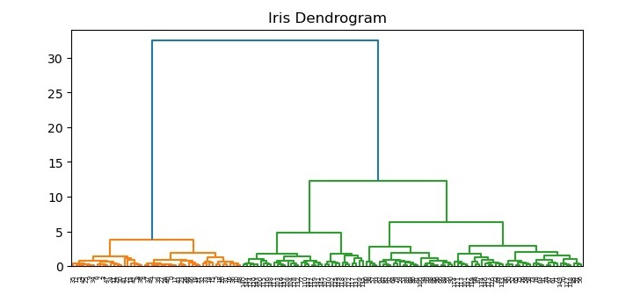
The resulting Dendogram

Slide 32
Advantages of Agglomerative Clustering
Produces a dendrogram that shows the hierarchical relationship between the clusters.
Can handle different types of distance metrics and linkage methods.
Allows for a flexible number of clusters to be extracted from the data.
Can handle large datasets with efficient implementations.
Disadvantages of Agglomerative Clustering
Can be computationally expensive for large datasets.
Can produce imbalanced clusters if the distance metric or linkage method is not appropriate for the data.
The final result may be sensitive to the choice of distance metric and linkage method used.
The dendrogram may be difficult to interpret for large datasets with many clusters.

Slide 33
Balanced Iterative Reducing and Clustering using Hierarchies (BIRCH)
Balanced Iterative Reducing and Clustering using Hierarchies (BIRCH) is a clustering algorithm that can cluster large datasets by first generating a small and compact summary of the large dataset that retains as much information as possible. This smaller summary is then clustered instead of clustering the larger dataset.
Based on factors such as Cluster feature.
BIRCH has one major drawback – it can only process metric attributes

Slide 34
Parameters of BIRCH Algorithm :
threshold : threshold is the maximum number of data points a sub-cluster in the leaf node of the CF tree can hold.
branching_factor : This parameter specifies the maximum number of CF sub-clusters in each node (internal node).
n_clusters : The number of clusters to be returned after the entire BIRCH algorithm is complete i.e., number of clusters after the final clustering step. If set to None, the final clustering step is not performed and intermediate clusters are returned.
Implementation of BIRCH
from sklearn.cluster import Birch
#Creating the BIRCH clustering model
model = Birch(branching_factor = 50, n_clusters = None, threshold = 1.5)
# Fit the data (Training)
model.fit(dataset)

Slide 35
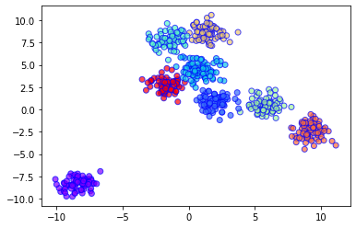
Output Plot: To create 8 clusters with 600 randomly generated samples

Slide 36
Evaluation metrics for clustering algorithms
Silhouette Coefficient
Assessment: This metric evaluates cohesion within clusters and separation between them.
Range: It varies from -1 (poor clustering) to 1 (excellent clustering).
Usage: Higher scores suggest better-defined clusters with good separation and tightness.
Rand Index (RI)
Measurement: It assesses the agreement between the predicted clusters and ground truth labels.
Scale: The index ranges from 0 (random clustering) to 1 (perfect agreement).
2. Adjusted Rand Index (ARI)
Improvement Over RI: This is a corrected version that accounts for chance agreement, offering a more robust evaluation.
Preferred Use: ARI is often favored for its reliability in various clustering scenarios.
3. Normalized Mutual Information (NMI)
Insight: NMI measures the mutual information between predicted clusters and ground truth, normalized by entropy.
Higher Scores: They indicate a greater similarity between the clustering outcome and the actual distribution.

